Slide 1
LinkedList
Lecture 15

Slide 2
Learning objectives
After the completion of today’s session you will be able to:
Define LinkedList.
Illustrate the example of using LinkedList.

Slide 3
Introduction
Linked List are linear data structures where the elements are not stored in contiguous locations and every element is a separate object with a data part and address part.
The elements are linked using pointers and addresses. Each element is known as a node.
Due to the dynamicity and ease of insertions and deletions, they are preferred over the arrays.
It also has few disadvantages like the nodes cannot be accessed directly instead we need to start from the head and follow through the link to reach to a node we wish to access.

Slide 4
Important points
Java LinkedList class can contain duplicate elements.
Java LinkedList class maintains insertion order.
Java LinkedList class is non synchronized.
In Java LinkedList class, manipulation is fast because no shifting needs to be occurred.
Java LinkedList class can be used as list, stack or queue.

Slide 5
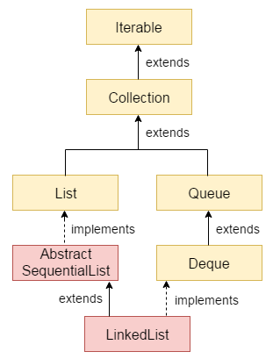
Hierarchy of LinkedList class

Slide 6
Constructors of LinkedList
LinkedList(): Used to create an empty linked list.
LinkedList(Collection C): Used to create a ordered list which contains all the elements of a specified collection, as returned by the collection’s iterator.

Slide 7
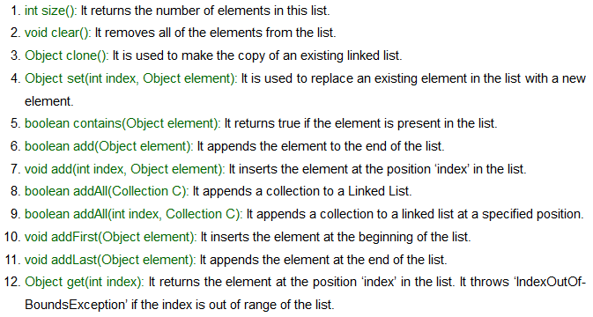
Methods in LinkedList

Slide 8
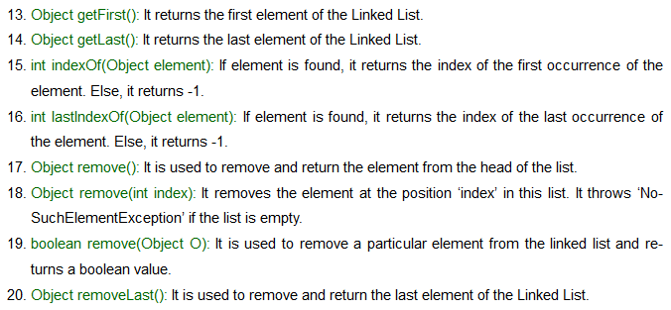
Methods in LinkedList

Slide 9
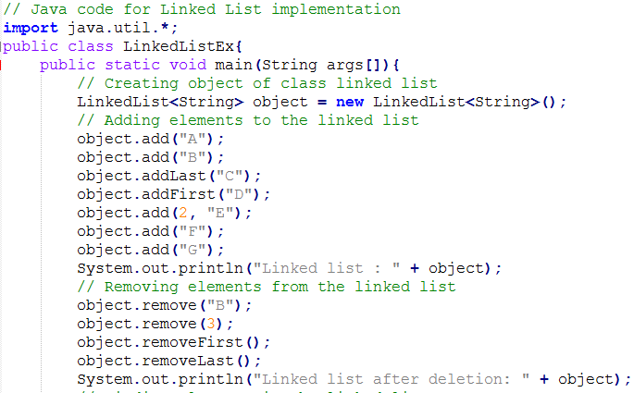
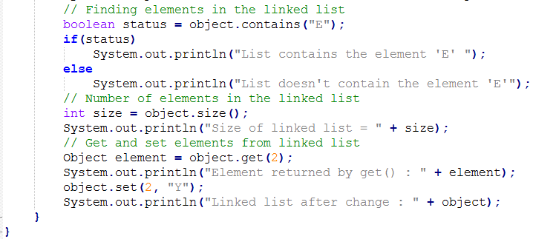
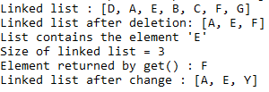
Example 1:
Output:

Slide 10
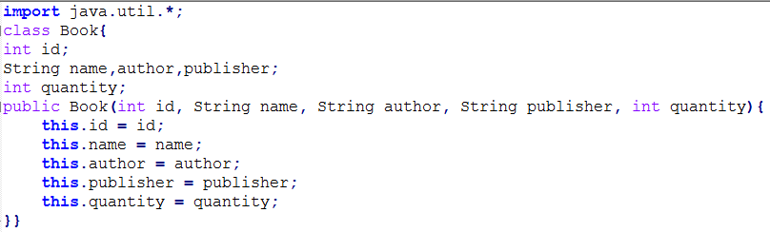
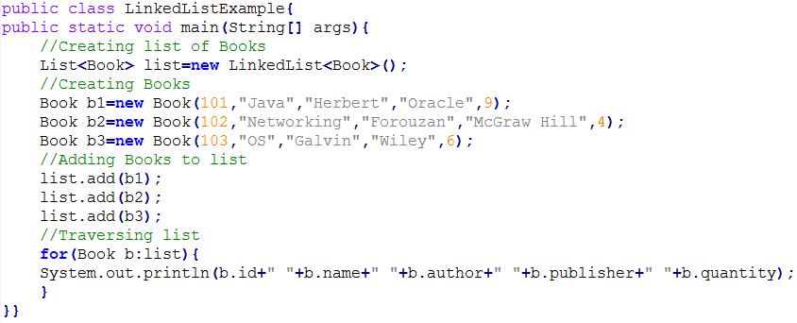

Example 2:
Output:

Slide 11
Thanks

